Slide 1
External Configuration Pattern
Created By: Md. Sahidul Islam

Slide 2
Contents
Context and Problem
Solution
Issues and considerations
When to use

Slide 3
Context and Problem
The majority of application runtime environments include configuration information
  Changes to the configuration require the application be redeployed
Local configuration files also limit the configuration to a single application
  Examples include database connection strings, UI theme information, or the URLs of queues and storage used by a related set of applications.
Challenging to manage changes to local configurations across multiple running instances
  Can result in instances using different configuration settings while the update is being deployed.

Slide 4
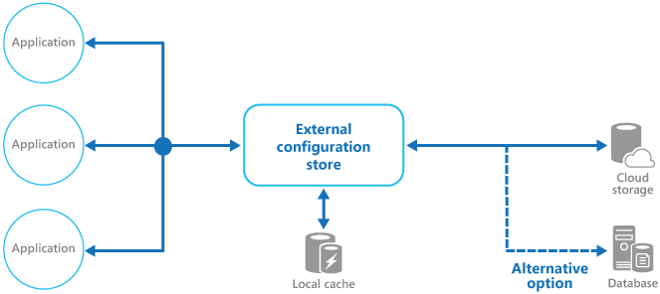
Solution
Store the configuration information in external storage
Provide an interface that can be used to quickly and efficiently read and update configuration settings.

Slide 5
Issues and considerations
Choose a backing store that offers
  Acceptable performance
  High availability
  Robustness
  Can be backed up
Ensure Security

Slide 6
When to Use
Configuration settings that are shared between multiple applications and application instances, or where a standard configuration must be enforced across multiple applications and application instances.
A standard configuration system that doesn't support all of the required configuration settings, such as storing images or complex data types.
As a complementary store for some of the settings for applications, perhaps allowing applications to override some or all of the centrally-stored settings.
As a way to simplify administration of multiple applications, and optionally for monitoring use of configuration settings by logging some or all types of access to the configuration store.

